Slide 1

Project 1 Numerical Reservoir Simulation
SUMMARY OF RESULTS
Prateek Bhardwaj
pb22734

Slide 2
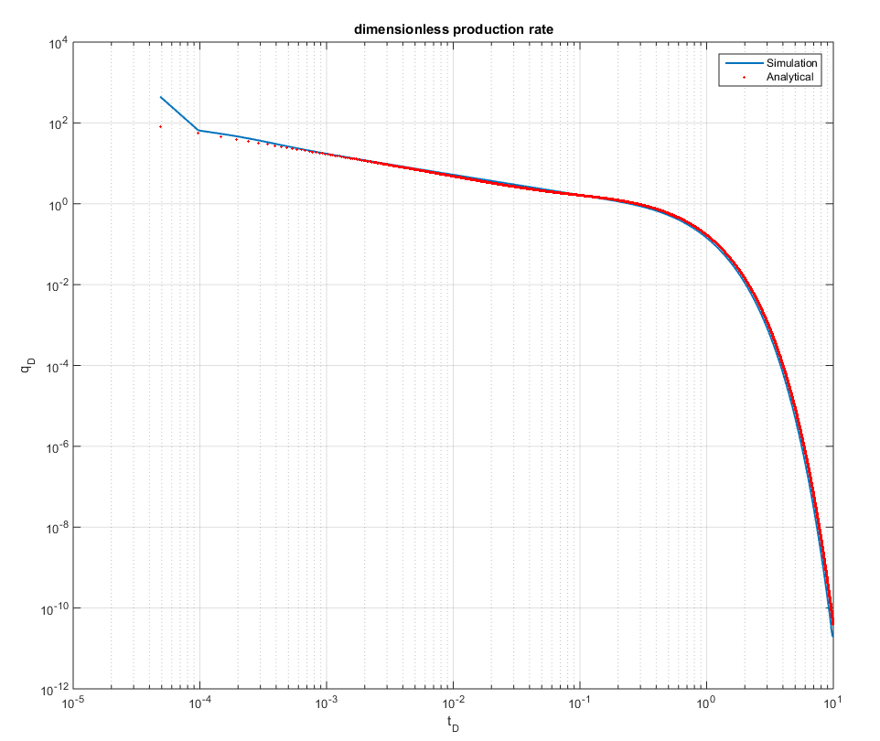
Model Validation
% Validation.m
There is a difference between numerical and analytical solutions in the early rate values because this is the transient state. The solution used for analytical is approximated using error function.
xe = 2550; % drainage boundary(ft)
xf = 50; % Half length of the Fracture(ft)
xwf = 0; % wellbore x coordinate(ft)
L= 2*(xe); % Distance between two fractures(ft)

Slide 3
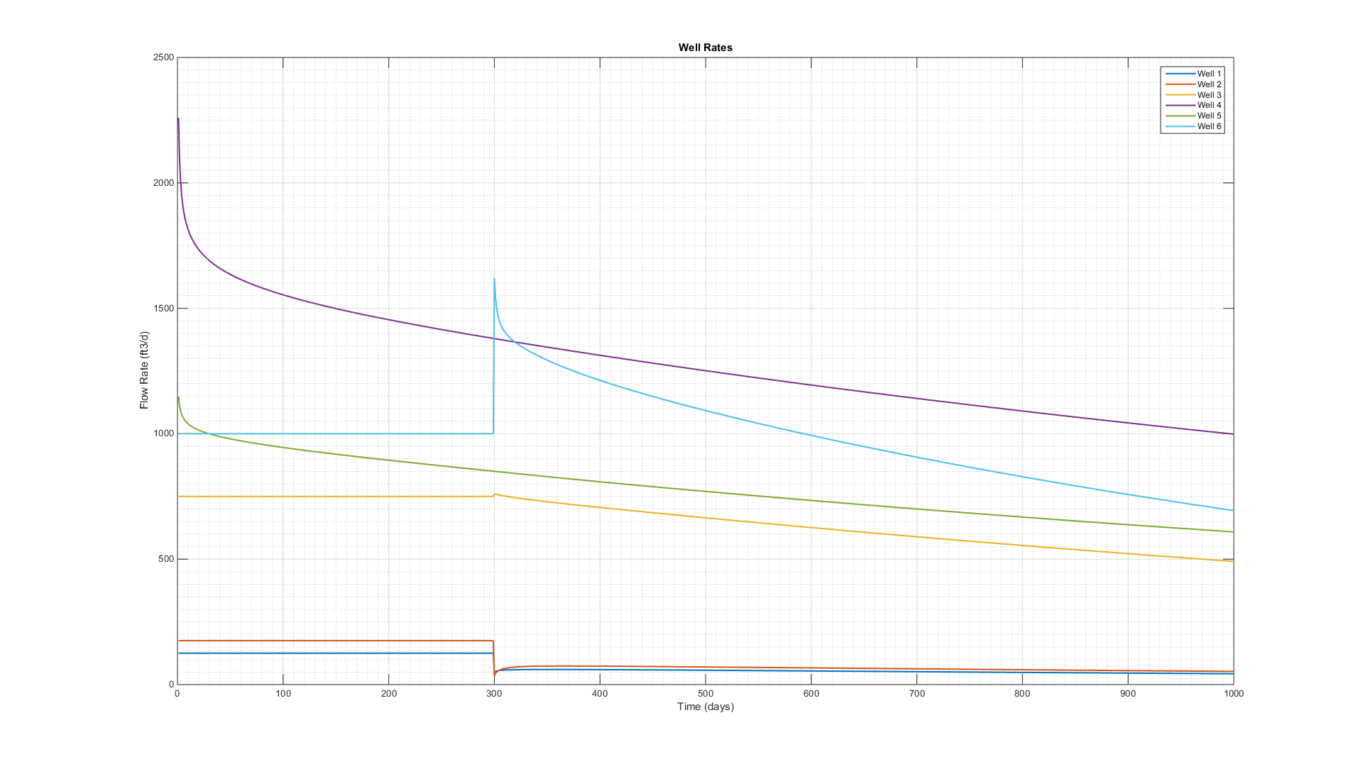
Well Rates
% Prateek Bhardwaj_final.m

Slide 4
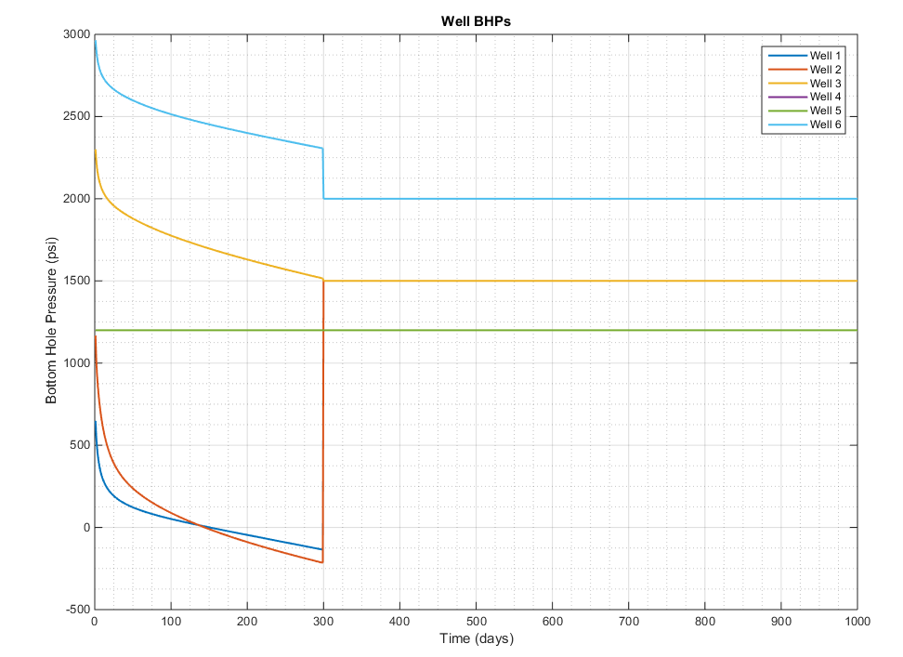
Well Bottom Hole Pressures
% Prateek Bhardwaj_final.m

Slide 5
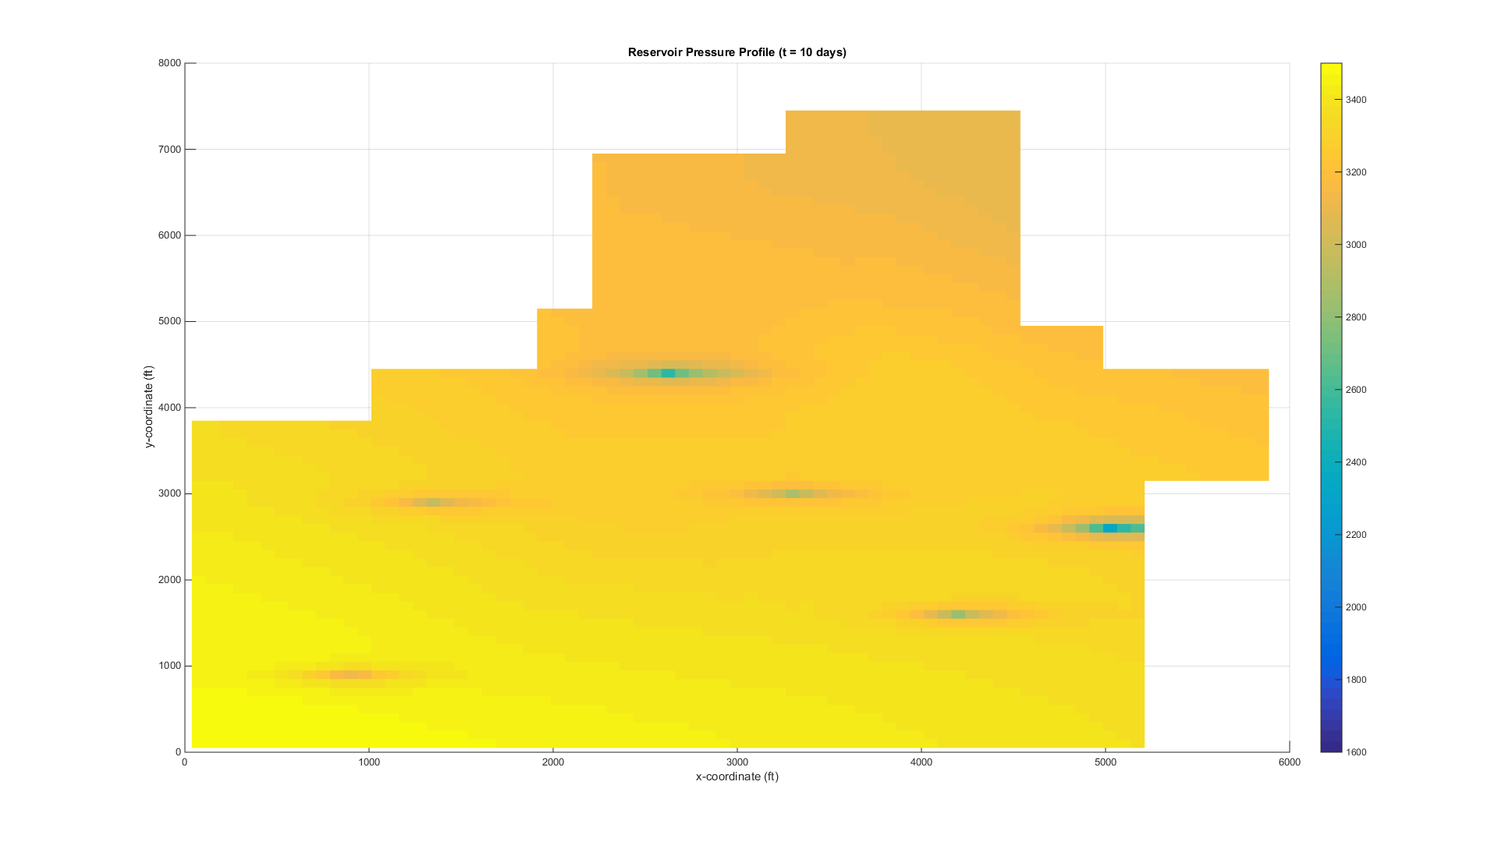
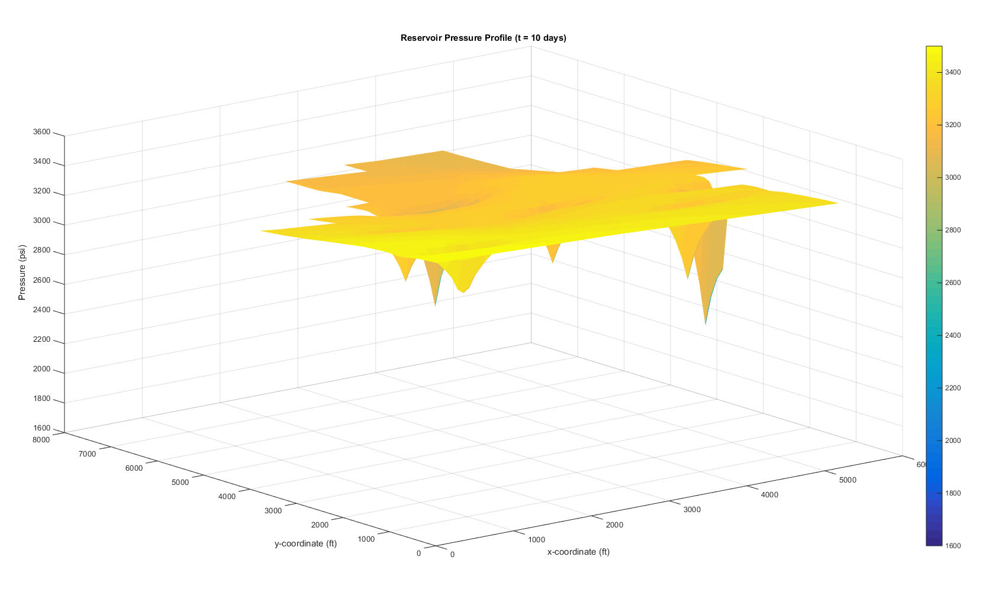
Pressure Profile @ 10 days
% Prateek Bhardwaj_final.m

Slide 6
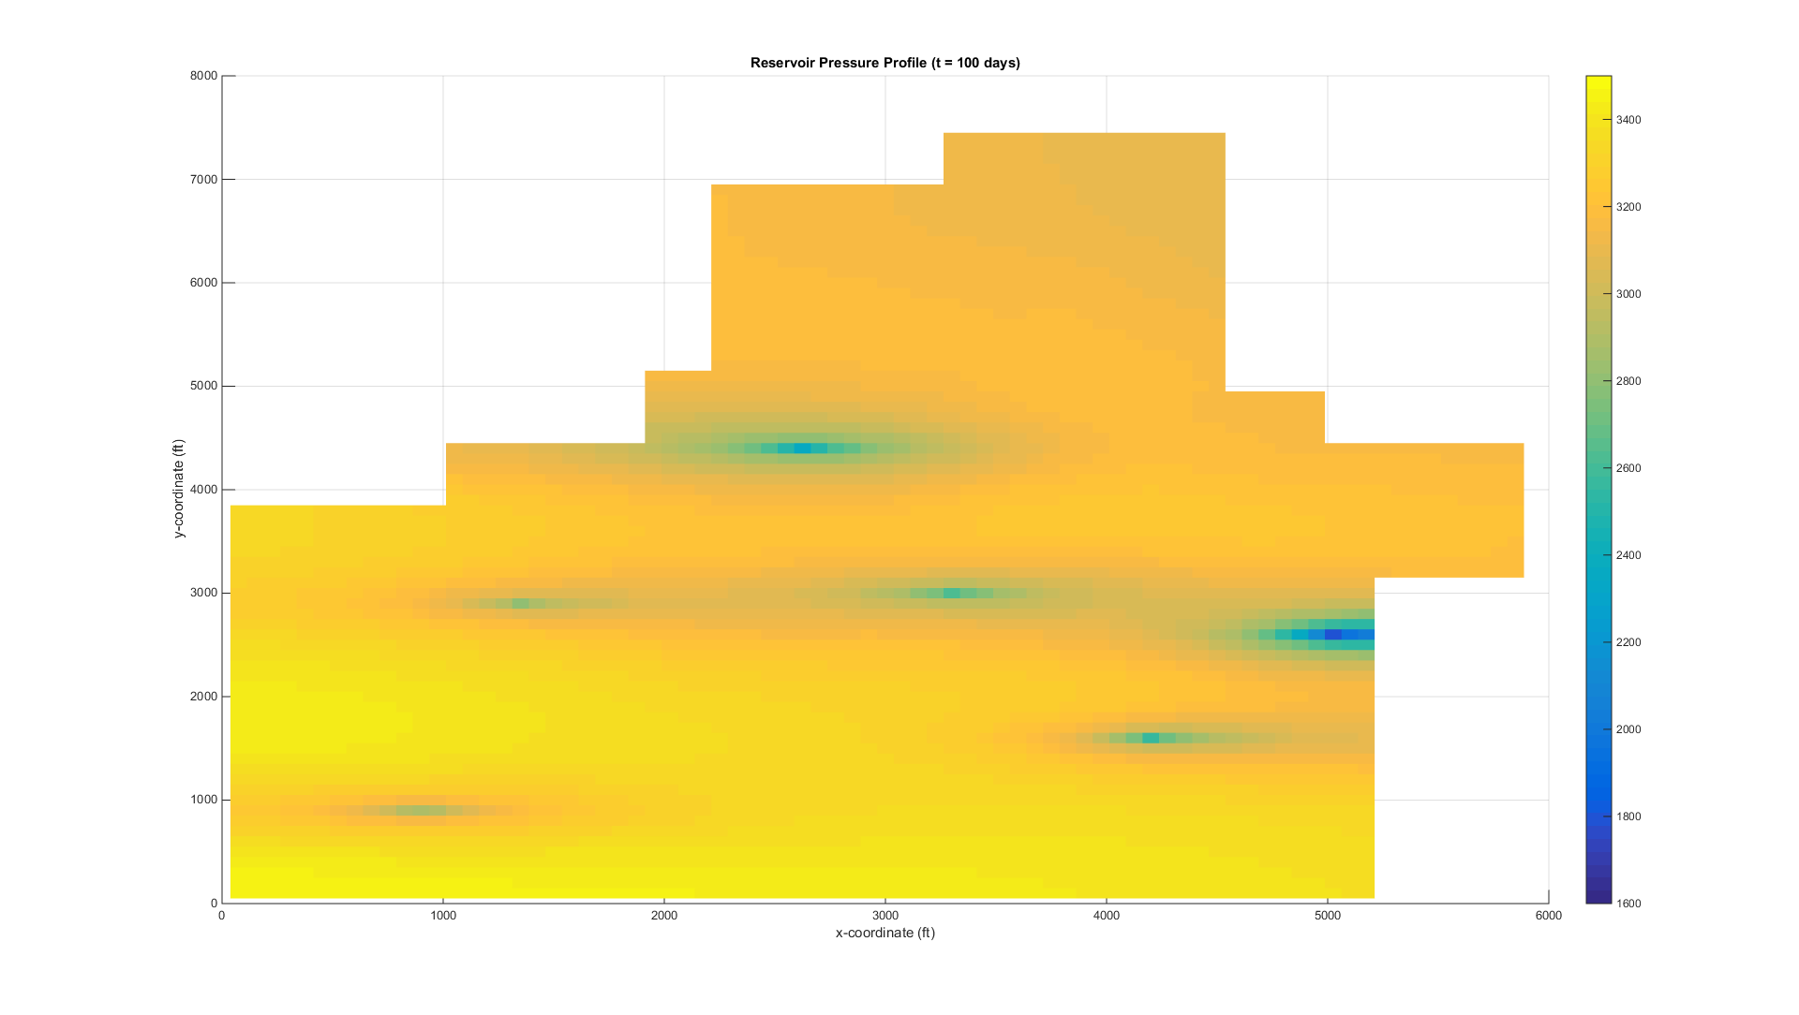
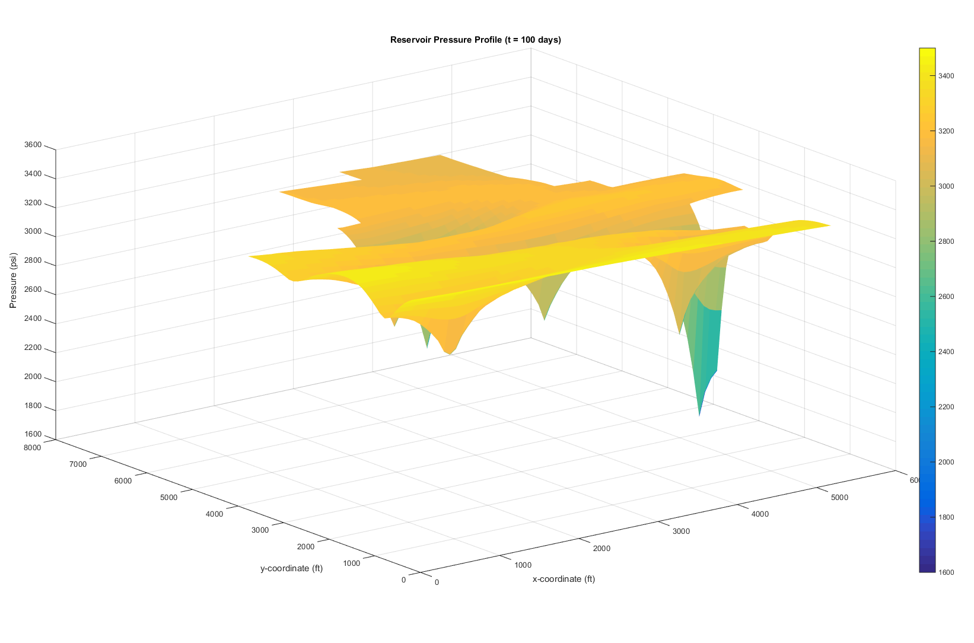
Pressure Profile @ 100 days
% Prateek Bhardwaj_final.m

Slide 7
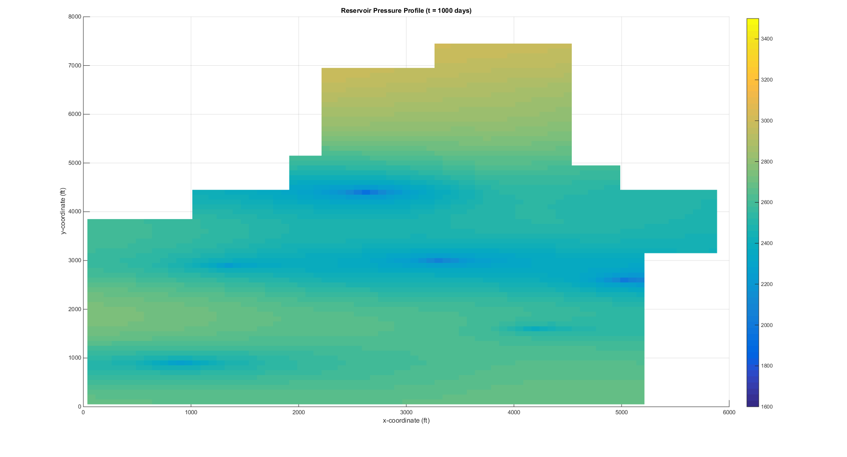
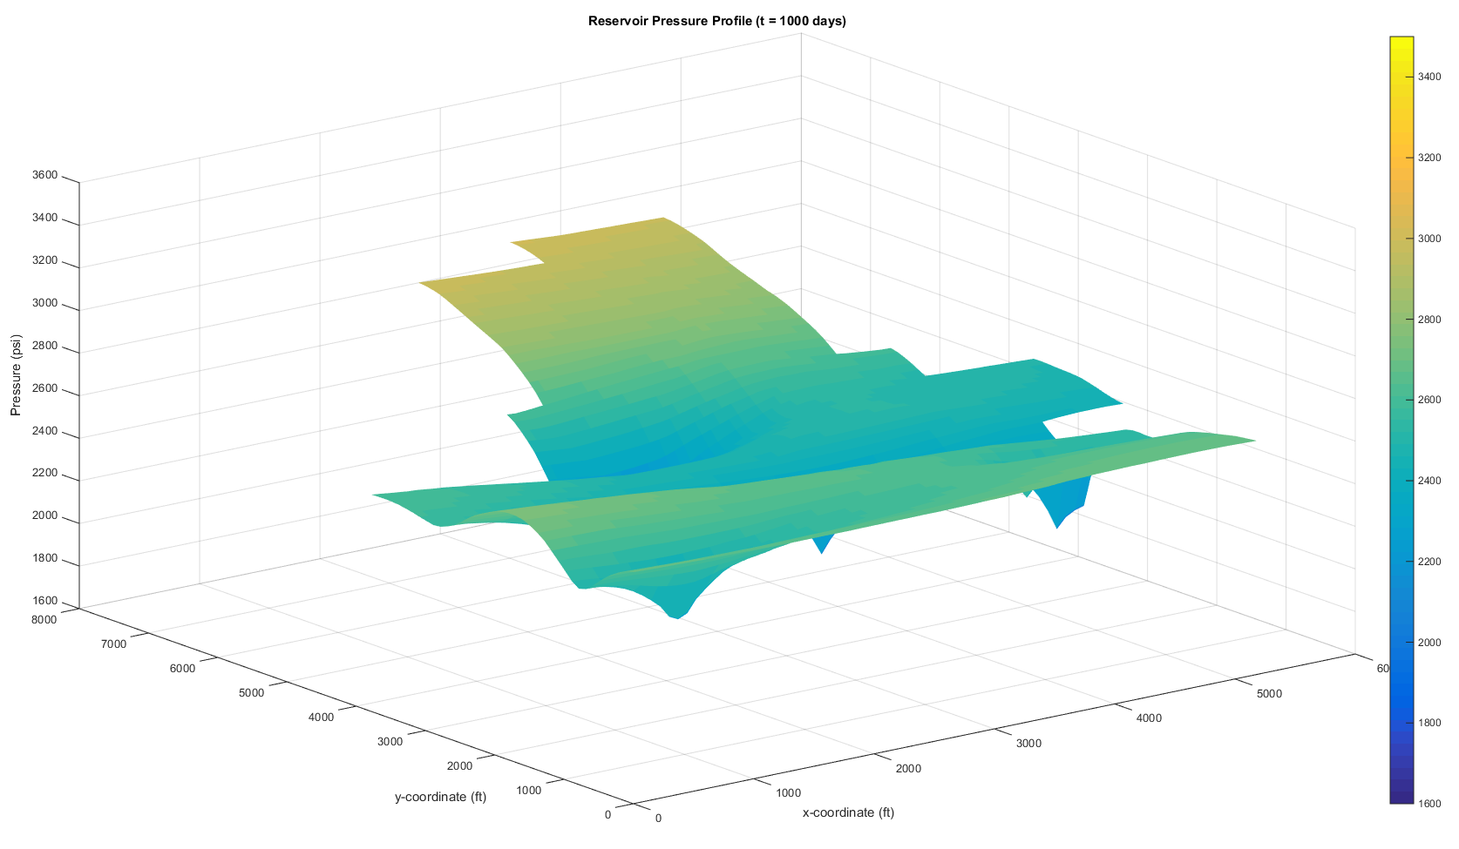
Pressure Profile @ 1000 days
% Prateek Bhardwaj_final.m

Slide 8
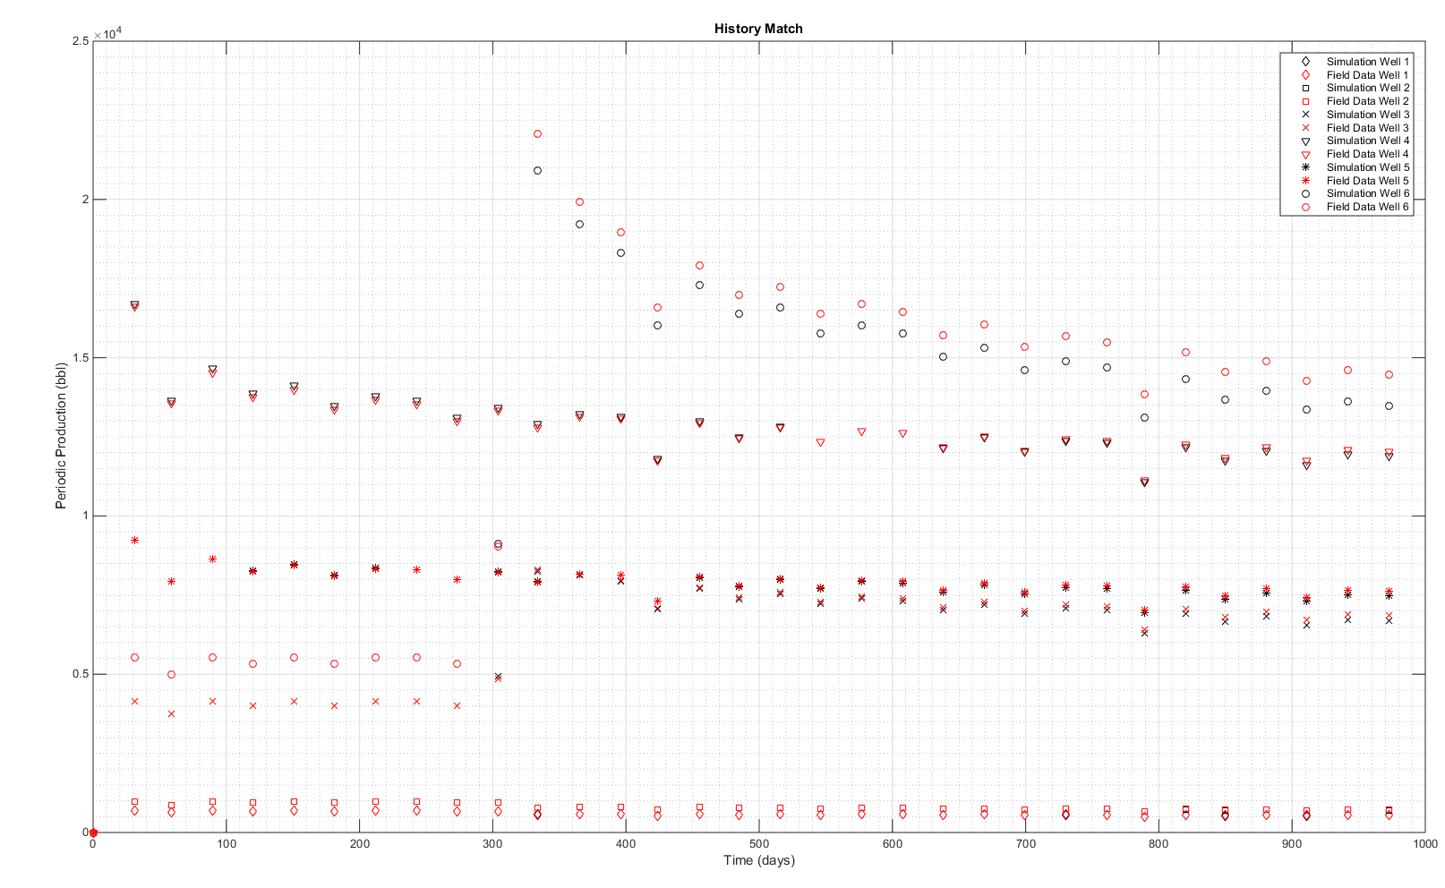
History Match
% history_match.m

